Slide 1

Chapter 19
File Transfer:
FTP and TFTP
Objectives
Upon completion you will be able to:
Understand the connections needed for FTP file transfer
Be familiar with FTP commands and responses
Know the differences between FTP and TFTP
Be familiar with TFTP message types
Understand TFTP flow and error control

Slide 2
19.1 FILE TRANSFER
PROTOCOL (FTP)
File Transfer Protocol (FTP) is the standard mechanism provided by TCP/IP for copying a file from one host to another.
The topics discussed in this section include:
Connections
Communication
Command Processing
File Transfer
Anonymous FTP

Slide 3

Note:
FTP uses the services of TCP. It needs two TCP connections.
The well-known port 21 is used for the control connection and the well-known port 20 for the data connection.

Slide 4
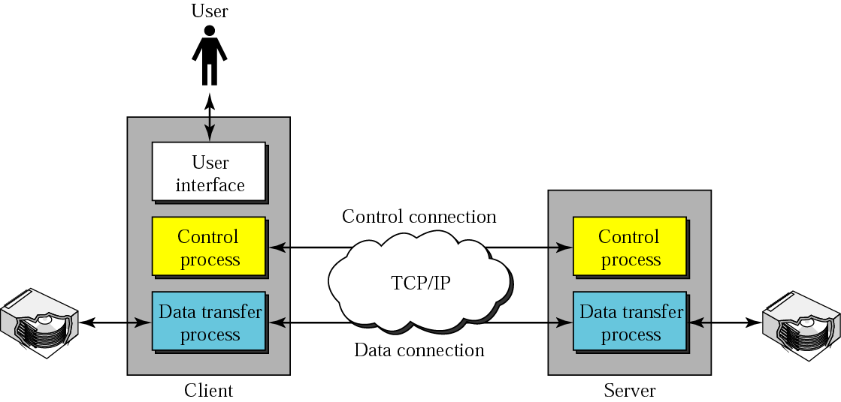
Figure 19.1 FTP

Slide 5
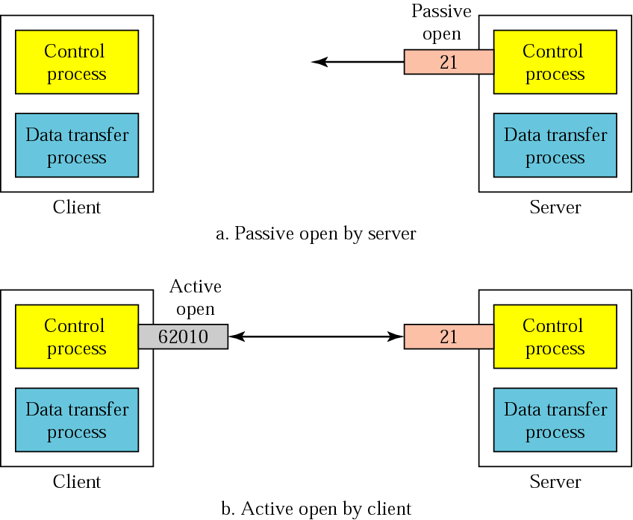
Figure 19.2 Opening the control connection

Slide 6
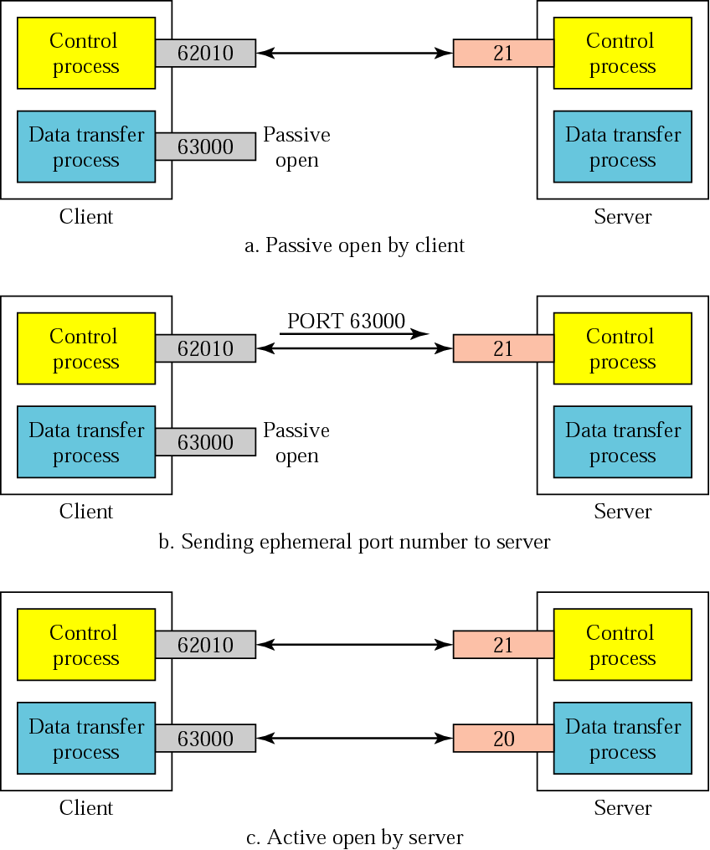
Figure 19.3 Creating the data connection

Slide 7
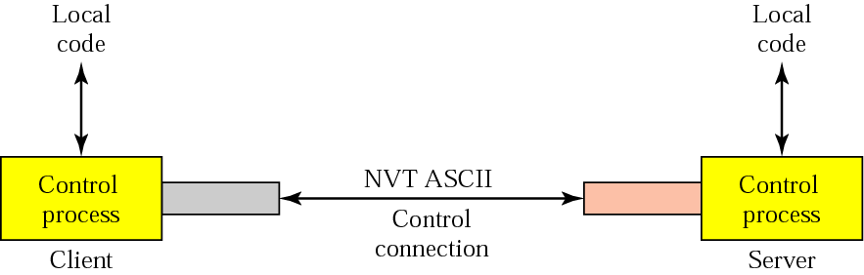
Figure 19.4 Using the control connection

Slide 8
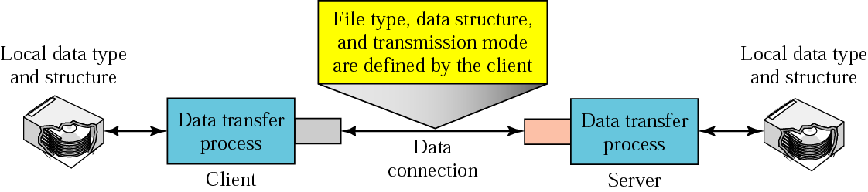
Figure 19.5 Using the data connection

Slide 9
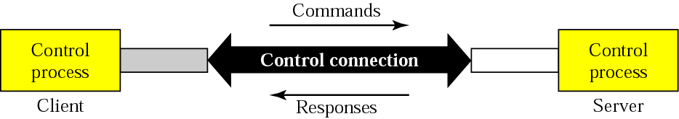
Figure 19.6 Command processing

Slide 10
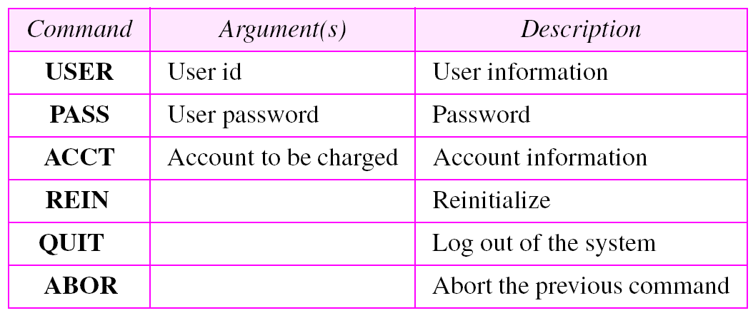
Table 19.1 Access commands

Slide 11
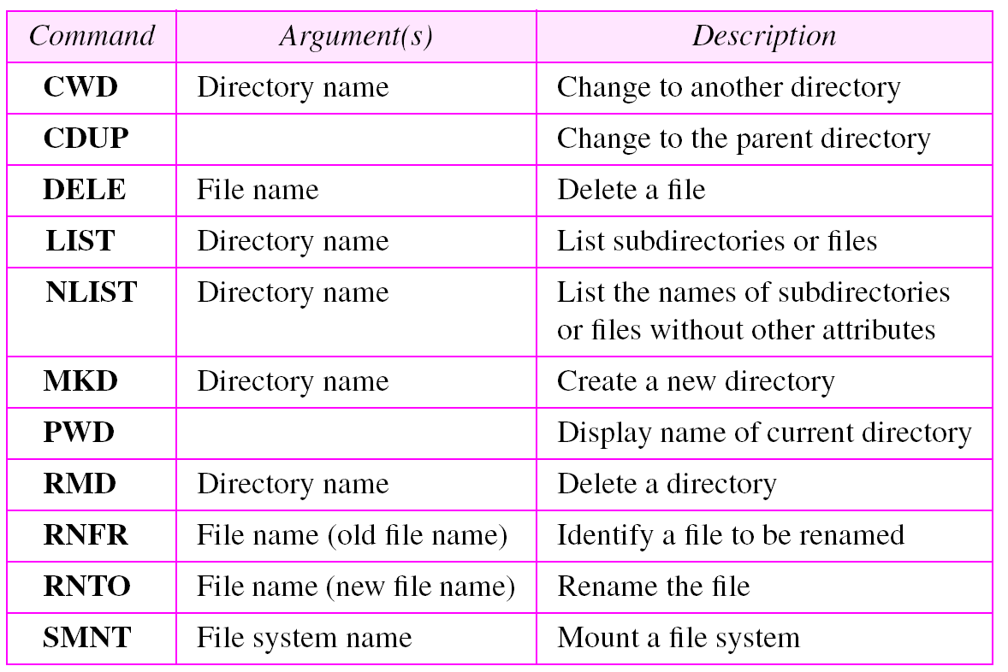
Table 19.2 File management commands

Slide 12
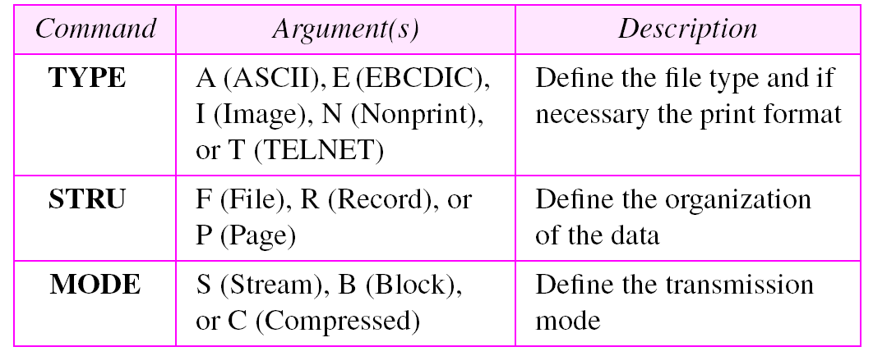
Table 19.3 Data formatting commands

Slide 13
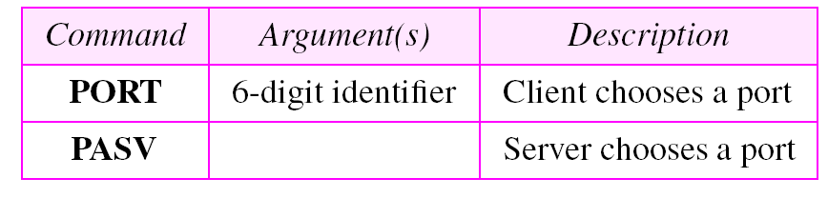
Table 19.4 Port defining commands

Slide 14
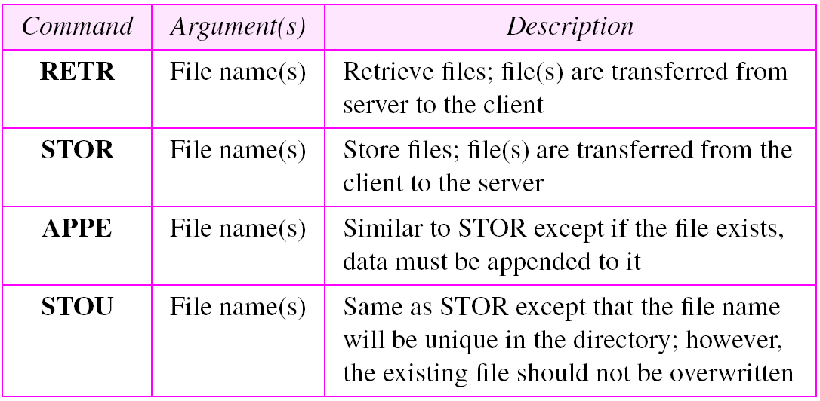
Table 19.5 File transfer commands

Slide 15
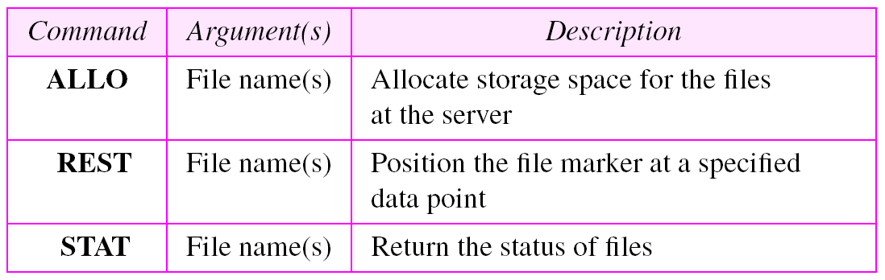
Table 19.5 File transfer commands (continued)

Slide 16
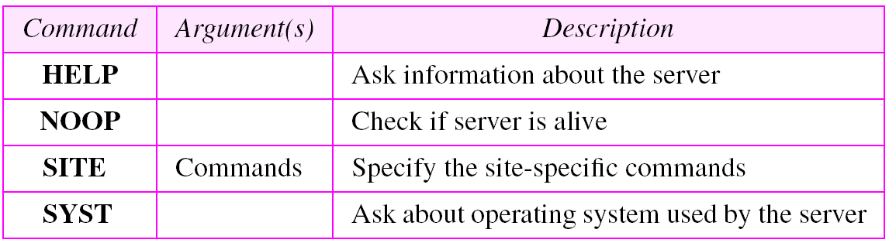
Table 19.6 Miscellaneous commands

Slide 17
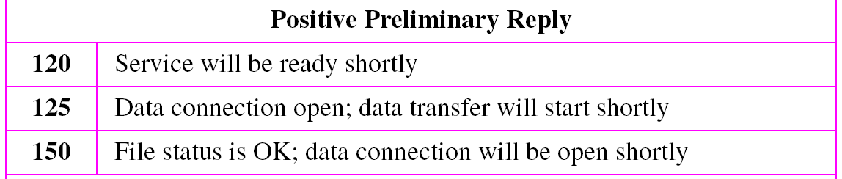
Table 19.7 Responses

Slide 18
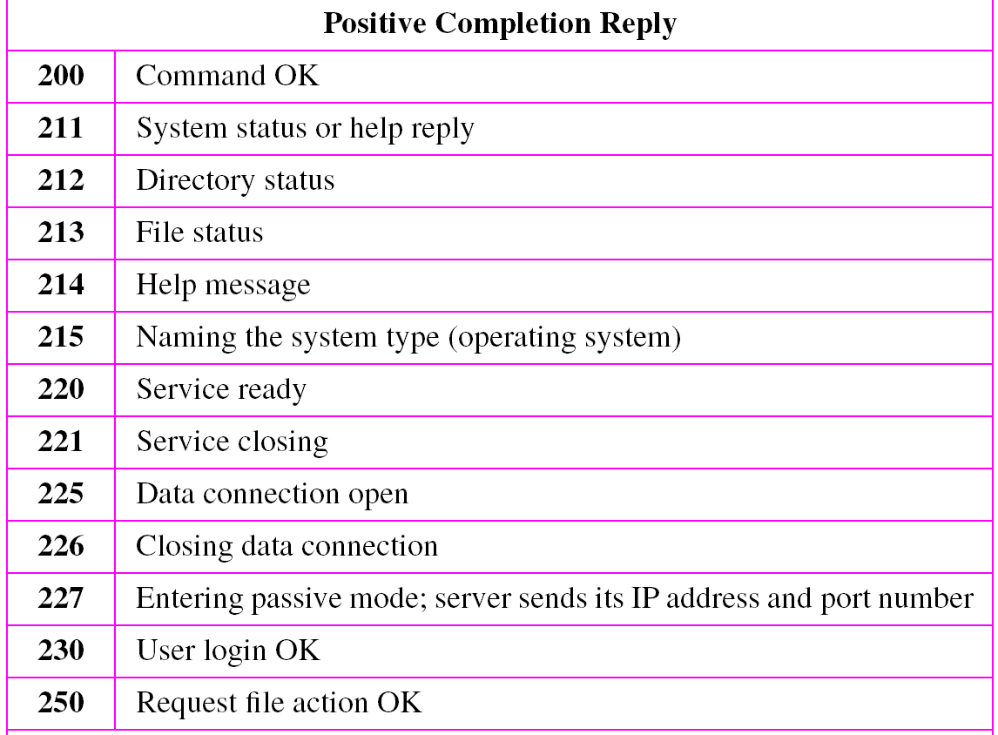
Table 19.7 Responses (continued)

Slide 19
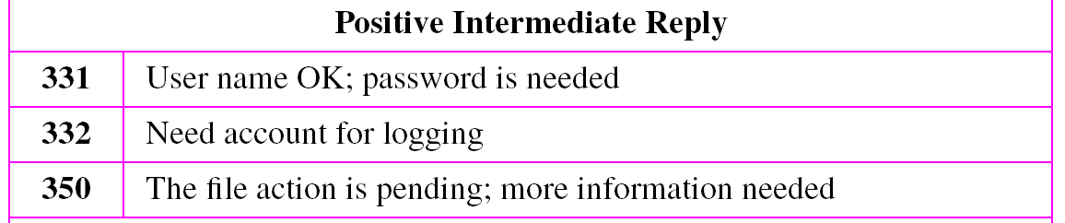
Table 19.7 Responses (continued)

Slide 20
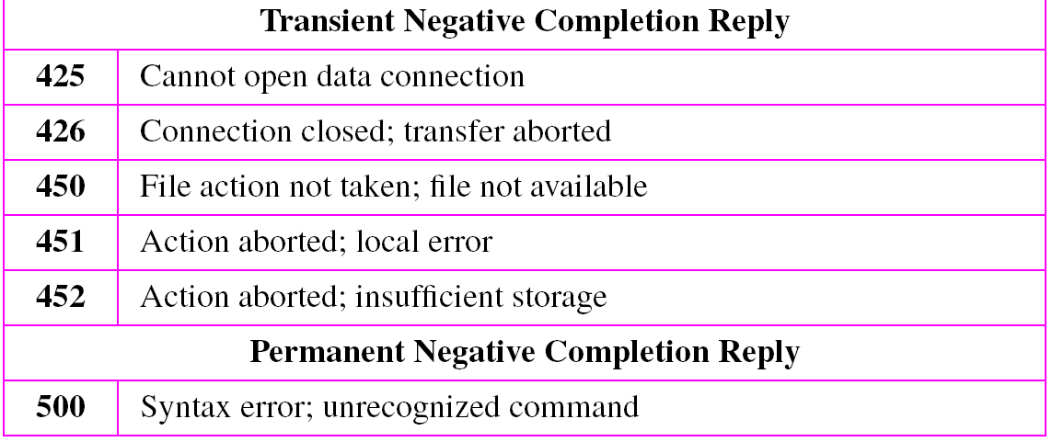
Table 19.7 Responses (continued)
Table 19.7 Responses (continued)

Slide 21
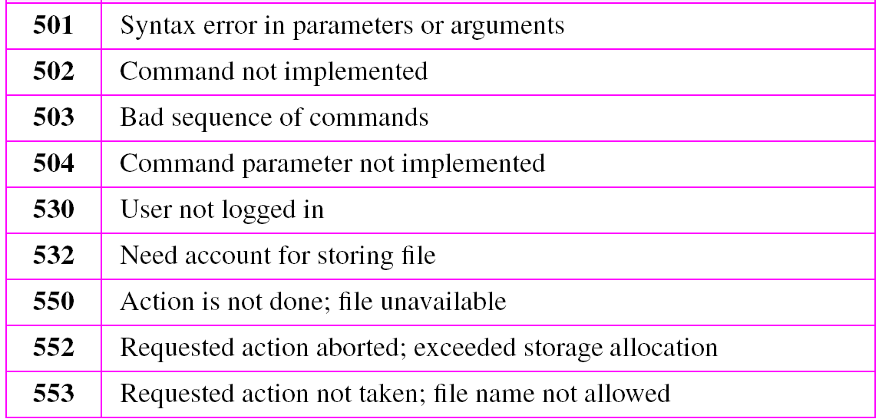
Table 19.7 Responses (continued)
Table 19.7 Responses (continued)

Slide 22
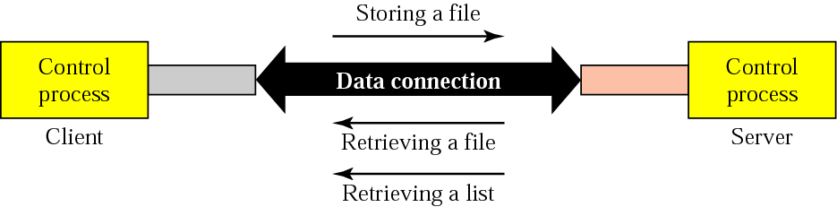
Figure 19.7 File transfer

Slide 23
Example 1
Figure 19.8 shows an example of using FTP for retrieving a list of items in a directory.
1. After the control connection to port 21 is created, the FTP
server sends the 220 (service ready) response on the control
connection.
2. The client sends the USER command.
3. The server responds with 331 (user name is OK, password is
required).
4. The client sends the PASS command.
5. The server responds with 230 (user login is OK)
See Next Slide

Slide 24
Example 1 (cONTINUED)
6. The client issues a passive open on an ephemeral port for the
data connection and sends the PORT command (over the
control connection) to give this port number to the server.
7. The server does not open the connection at this time, but it
prepares itself for issuing an active open on the data
connection between port 20 (server side) and the ephemeral
port received from the client. It sends response 150 (data
connection will open shortly).
8. The client sends the LIST message.
9. Now the server responds with 125 and opens the data
connection.
See Next Slide

Slide 25
Example 1 (cONTINUED)
10. The server then sends the list of the files or directories (as a
file) on the data connection. When the whole list (file) is
sent, the server responds with 226 (closing data connection)
over the control connection.
11. The client now has two choices. It can use the QUIT
command to request the closing of the
control connection or it can send another command to
start another activity (and eventually open another data
connection). In our example, the client sends a QUIT
command.
12. After receiving the QUIT command, the server responds
with 221 (service closing) and then closes the control
connection.
See Next Slide

Slide 26
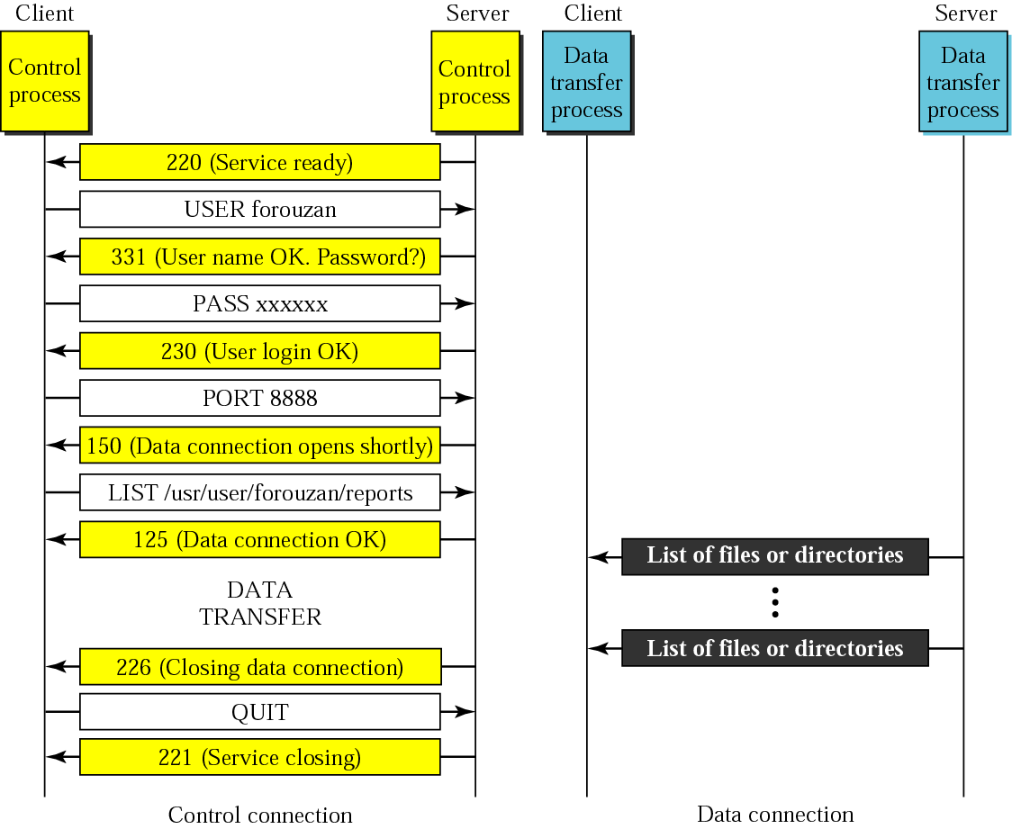
Figure 19.8 Example 1

Slide 27
Example 2
The following shows an actual FTP session that parallels Example 1. The colored lines show the responses from the server control connection; the black lines show the commands sent by the client. The lines in white with black background shows data transfer.
$ ftp voyager.deanza.fhda.edu
Connected to voyager.deanza.fhda.edu.
220 (vsFTPd 1.2.1)
530 Please login with USER and PASS.
Name (voyager.deanza.fhda.edu:forouzan): forouzan
331 Please specify the password.
See Next Slide

Slide 28
Example 2
Password:
230 Login successful.
Remote system type is UNIX.
Using binary mode to transfer files.
ftp> ls reports
227 Entering Passive Mode (153,18,17,11,238,169)
150 Here comes the directory listing.
drwxr-xr-x 2 3027 411 4096 Sep 24 2002 business
drwxr-xr-x 2 3027 411 4096 Sep 24 2002 personal
drwxr-xr-x 2 3027 411 4096 Sep 24 2002 school
226 Directory send OK.
ftp> quit
221 Goodbye.

Slide 29
Example 3
Figure 19.9 shows an example of how an image (binary) file is stored.
1. After the control connection to port 21 is created, the FTP
server sends the 220 (service
ready) response on the control connection.
2. The client sends the USER command.
3. The server responds with 331 (user name is OK, a password
is required).
4. The client sends the PASS command.
5. The server responds with 230 (user login is OK).
6. The client issues a passive open on an ephemeral port for
the data connection and sends the PORT command (over
the control connection) to give this port number to the server.
See Next Slide

Slide 30
Example 3 (cONTINUED)
7. The server does not open the connection at this time, but
prepares itself for issuing an active
open on the data connection between port 20 (server side)
and the ephemeral port received
from the client. It sends the response 150 (data connection
will open shortly).
8. The client sends the TYPE command.
9. The server responds with the response 200 (command OK).
10. The client sends the STRU command.
11. The server responds with 200 (command OK).
12. The client sends the STOR command.
13. The server opens the data connection and sends the
response 250.
See Next Slide

Slide 31
Example 3 (cONTINUED)
14. The client sends the file on the data connection. After the
entire file is sent, the data connection is closed. Closing the
data connection means end-of-file.
15. The server sends the response 226 on the control
connection.
16. The client sends the QUIT command or uses other
commands to open another data connection
for transferring another file. In our example, the QUIT
command is sent.
17. The server responds with 221 (service closing) and it closes
the control connection.
See Next Slide

Slide 32
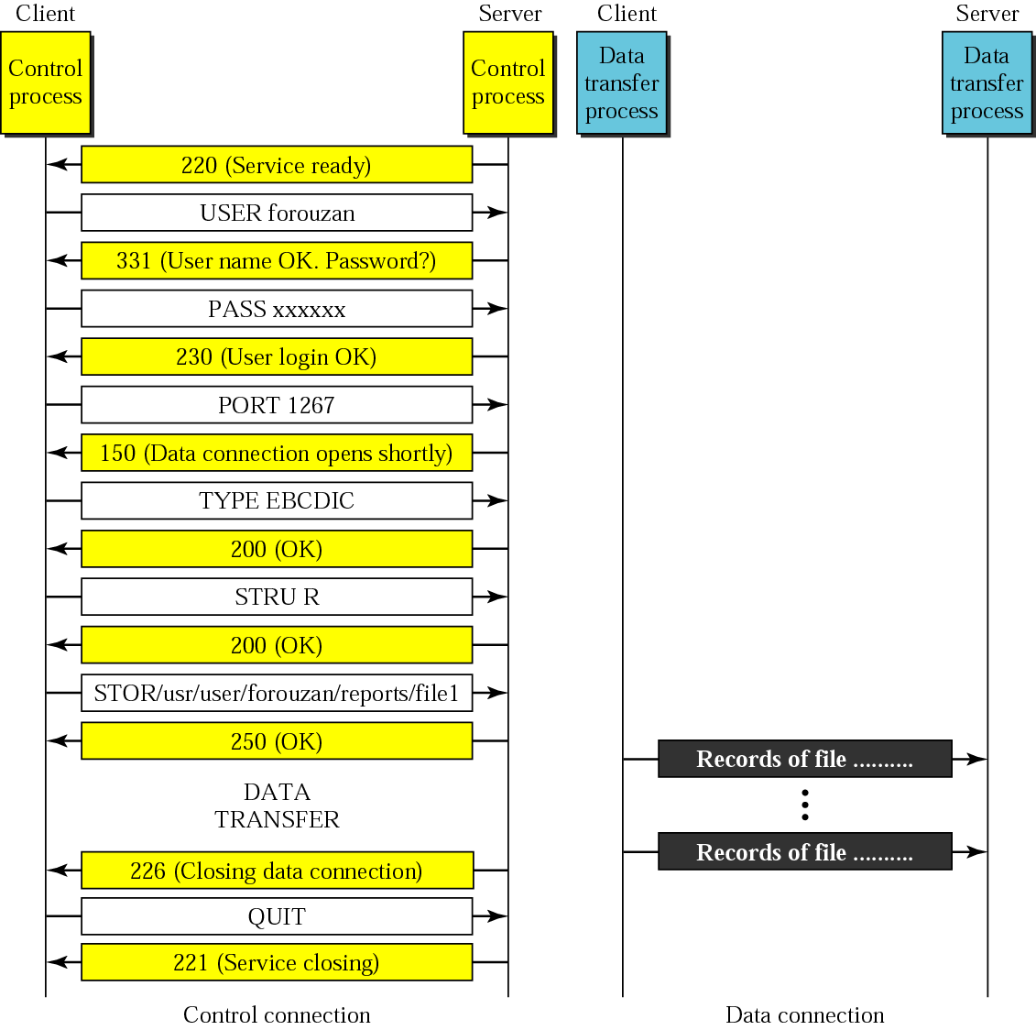
Figure 19.9 Example 3

Slide 33
Example 4
We show an example of anonymous FTP. We assume that
some public data are available at internic.net.
$ ftp internic.net
Connected to internic.net
220 Server ready
Name: anonymous
331 Guest login OK, send “guest” as password
Password: guest
ftp > pwd
257 ’/’ is current directory
See Next Slide

Slide 34
Example 4
bin
. . .
. . .
. . .
ftp > close
221 Goodbye
ftp > quit

Slide 35
19.2 TRIVIAL FILE TRANSFER
PROTOCOL (TFTP)
Trivial File Transfer Protocol (TFTP) is a simple file transfer protocol without the sophisticated features of FTP.
The topics discussed in this section include:
Messages
Connection
Data Transfer
UDP Ports
TFTP Example
TFTP Options
Security
Applications

Slide 36
Note:
TFTP uses the services of UDP on the well-known port 69.

Slide 37
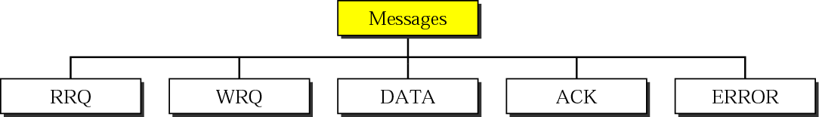
Figure 19.10 Message categories

Slide 38

Figure 19.11 RRQ format

Slide 39

Figure 19.12 WRQ format

Slide 40

Figure 19.13 DATA format

Slide 41

Figure 19.14 ACK format

Slide 42

Figure 19.15 ERROR format

Slide 43
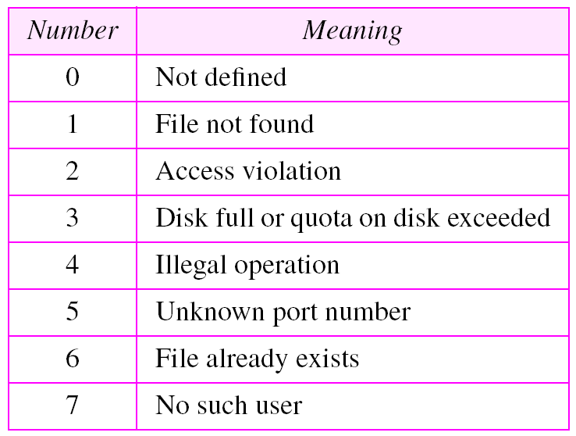
Table 19.8 Error numbers and their meanings

Slide 44
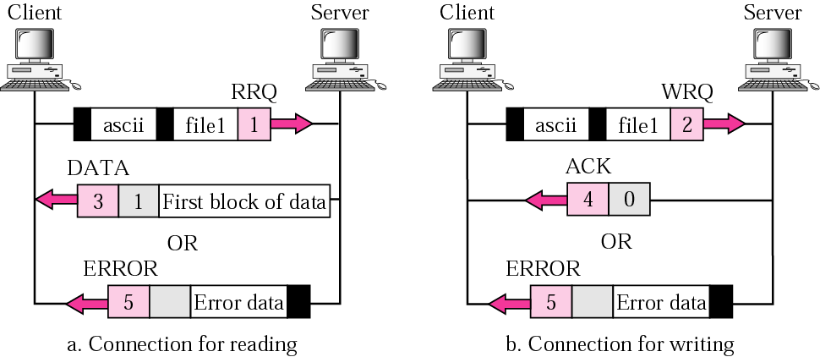
Figure 19.16 Connection establishment

Slide 45
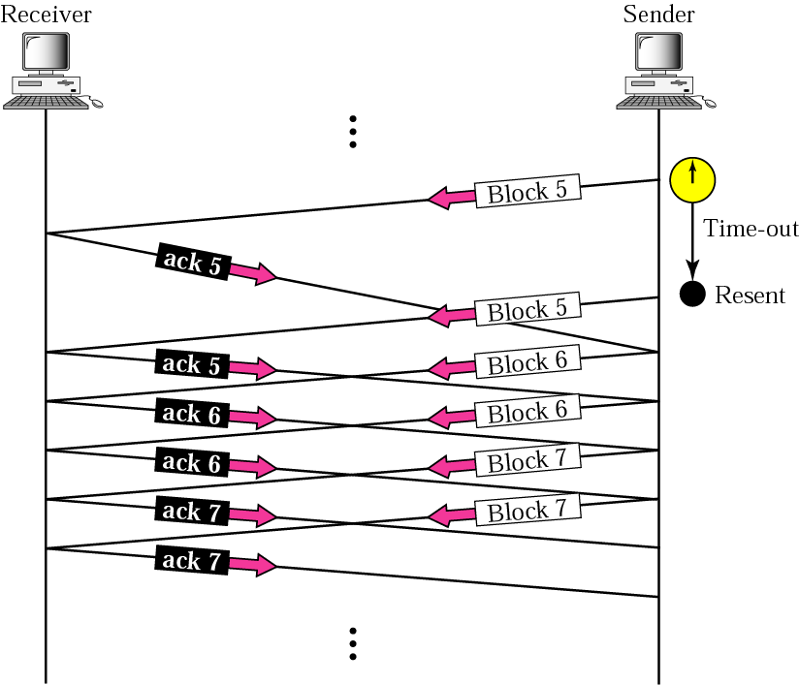
Figure 19.17 Sorcerer’s apprentice bug

Slide 46
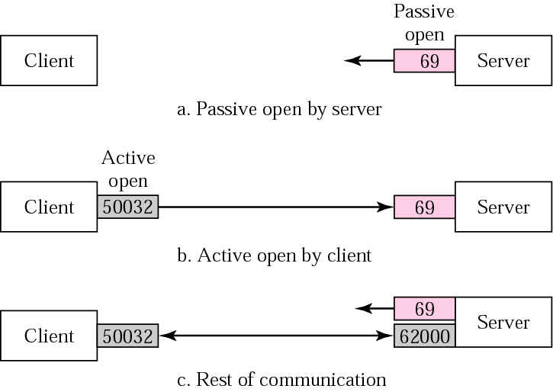
Figure 19.18 UDP port numbers used by TFTP

Slide 47
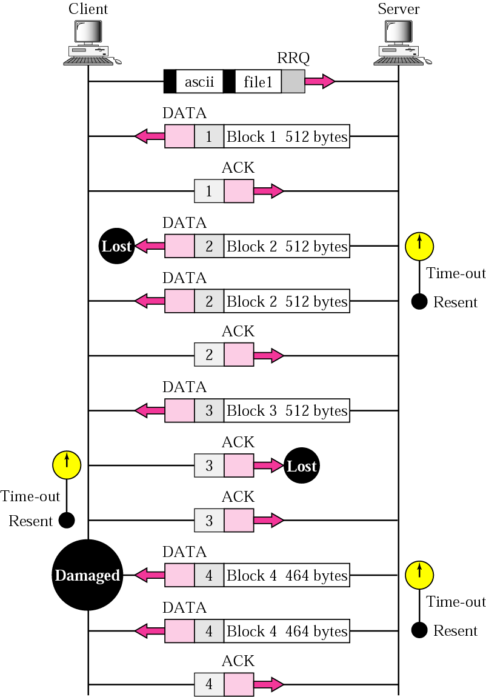
Figure 19.19 TFTP example

Slide 48
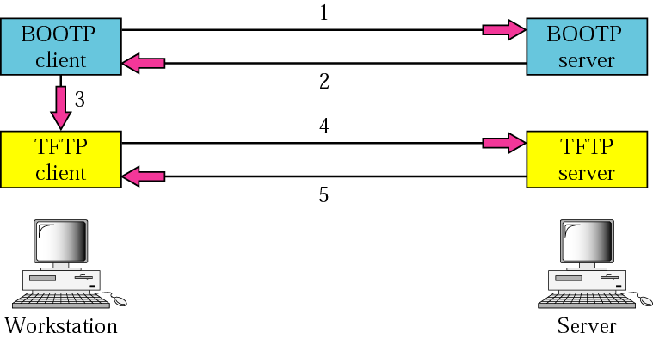
Figure 19.20 Use of TFTP with BOOTP

